Slide 1
IHVN PROGRAM DASHBOARD
UMB/IHVN

Slide 2
TARGET PROGRAMS
ART program
HTS program (Facility and Community)
PMTCT program
Integrated COVID-19/TB/HIV Testing program
Biometric Data Capture Program
Commodity Management

Slide 3
USE CASE
Analytics and Charts
Report Generation Module (Line List and Aggregate)
Data Quality Module
Biometric Deduplication Module
Data Triangulation Module
Patient Dashboard Module
Cloud Backup for all facilities

Slide 4
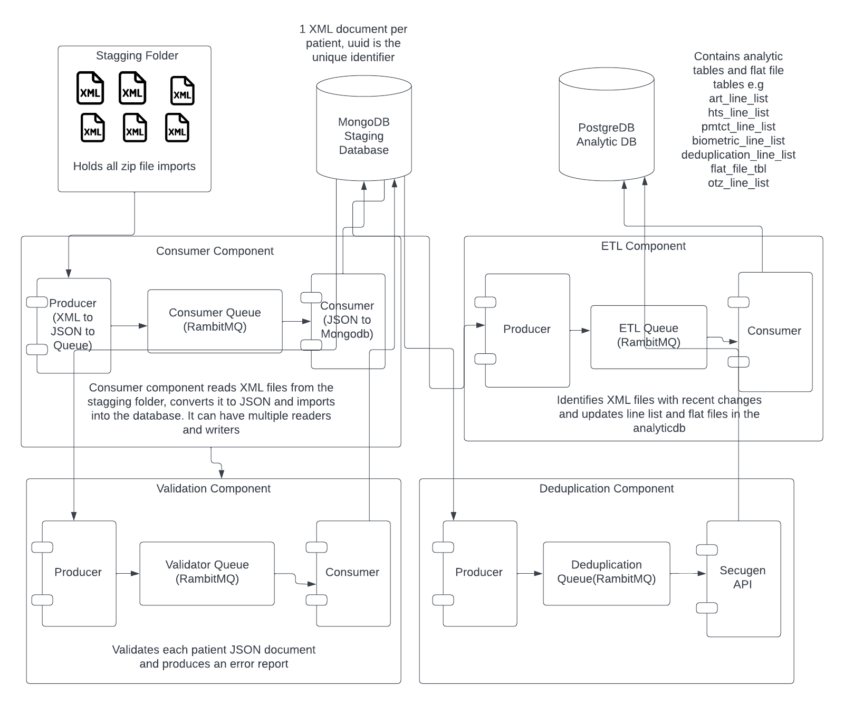

Slide 5
Staging
ETL
Analytic
IHVN Dashboard
Validator
Deduplication
Consumer
API/XML
CSV
CSV
API/XML
NMRS
NDR (Flat file)
DHIS (Non Treatment indicators)
Others

Slide 6
System Components
Consumer Service: Convert XML to JSON, API end point to receive data from the synch module
Staging Area Database (Mongodb): Mirrors database at facility, no validation rules
ETL Service: Populates Analytic database on a daily basis
Analytic Database (Postgredb): Subject based tables for easy analysis
NMRS Synch Module (Future version) : API communication to consumer service
Validator: Scans data for data quality issues
Deduplication Service: Matches finger prints
NMRS XML Extractor: Facilities without internet

Slide 7
TEAMS 1 (BACKEND SERVICES)
S/N | COMPONENT | TECHNOLOGY | DEPLOYMENT | RESPONSIBLE | TIMELINE
1. | NMRS Extractor Module | Java | NMRS Laptops | Team 1 | 2 days
2. | Consumer Service | Java | CDR System | Team 1 | 2 days
3. | ETL Service | Java | CDR System | Team 1 | 2 days
4. | Analytic DB | Postgre DB | CDR System | Team 1 | 2 days
5. | Staging Area DB | Mongo DB | CDR System | Team 1 | 2 days
6. | Validator Service | Java | CDR System | Team 1 | 2 days
7. | System Architecture/DevOps | Dell Poweredge T4400, Intel Xeon E-2224, 32GB DDR4-SDRAM, 2TB HDD, Two 495W PSU | Central Office | Team 1 | 2 days

Slide 8
TEAM 2 (UI/UX)
S/N | COMPONENT | RESPONSIBLE | TIMELINE
1. | Defining Variables in line list art_line_list pmtct_line_list hts_line_list recency_line_list | TEAM 2 | 2 days
2. | Defining Fundamental and Derived Cohorts Male Female Age <1 | TEAM 2 | 2 days
3. | Defining Validator Service Criteria Gender cannot be empty DateOfBirth cannot be empty | TEAM 2 | 2 days
4. | User Interface Design (Landing Page, Navigation, Menu) | TEAM 2 | 2 days
5. | Charts and Analytics | TEAM 2 | 2 days

Slide 9
TEAM 3
Project Management
Project Documentation
Research and System Design
DevOps
Logistics (Hotel, Complaints)

Slide 10
TEAM 1 COMPOSITION
S/N | NAMES | S/N | NAMES
1. | Morrisson Idiasirue (Team Lead)
2. | Tayo Oyelekan (Ast Team Lead)
3. | Aristotle Anana
4. | Ozordi Sandra
5. | Daniel Pam
6.

Slide 11
TEAM 2 COMPOSITION
S/N | NAMES | S/N | NAMES
1. | Scholarstica Olanrewaju (Team Lead) | 9. | Eunice Ekong
2. | Ibrahim Ahmed (Ast Team Lead)
3. | Chiagozie Achebe
4. | Martha Okposo
5. | Temitayo Raimi
6. | Anthony Nwokoma
7. | Ayoola Orisawayi
8. | Oluseun Temiye

Slide 12
TEAM 3 COMPOSITION
S/N | NAMES | S/N | NAMES
1. | Bright Ibezim (Team Lead)
2. | Sam Dakum
3. | Zayyan Bello
4. | Abdulkadir, Alhassan
5. | Ann Edegbe
6.

Slide 13
NEXT STEPS (MVP 30th June 2022)
S/N | PENDING TASKS | START DATE | END DATE | RESPONSIBLE
1. | Configure and Deploy MVP CDR | 16th May 2022 | 18th May 2022
2. | Commence Upload of XML files into CDR and fix all critical errors | 23rd May 2022 | 27th May 2022
3. | Reporting module (ART Line List export) | 30th May 2022 | 3rd June 2022
4. | Cohort Builder (TX_CURR, TX_NEW,TX_PVLS,TX_ML, TX_RTT) | 13th June 2022 | 18th June 2022
5. | Analytics (Phase 1) - Performance Monitoring | 20th June 2022 | 25th June 2022
6. | Testing and Matching with EMR and NDR Indicators | 27th June 2022 | 30th June 2022

